Slide 1
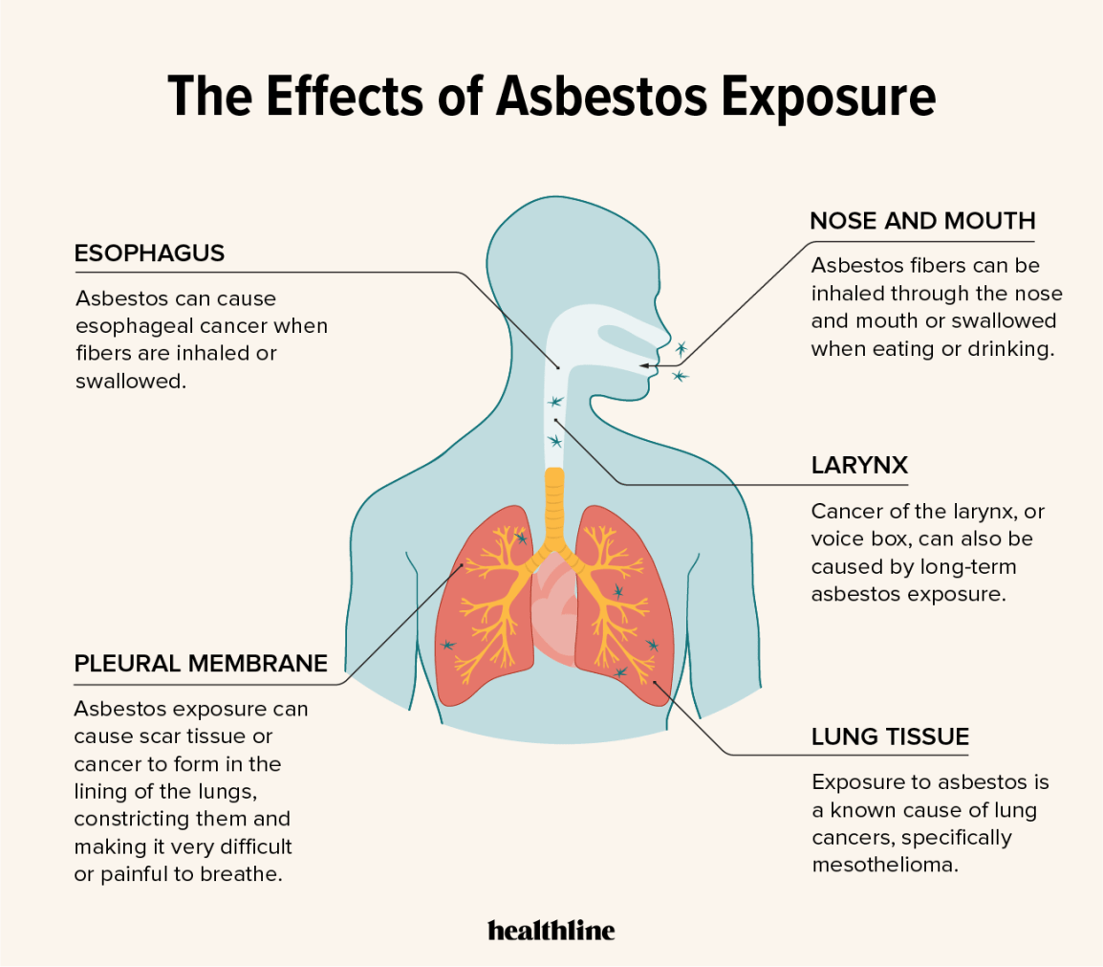
Linear Regression Analysis for Effect of Asbestos exposure (1991-1999) on pulmonary function testing
Presented by : Ravikumar Panchal

Slide 2
Outline
Introduction
Study Design and Analysis
Results
Discussion
Conclusion
References

Slide 3
introduction
The effect of asbestos exposure on pulmonary function was studied using data from the Navy Asbestos Medical Surveillance Program.
Records were selected for Caucasian men from 1991 to 1999 (N =89,318).
Analyzed using a cross sectional - linear regression model.
Dependent variables:
Forced expiratory volume in 1s (FEV1).
Forced vital capacity (FVC).
Independent continuous variables:
Age
Height
Weight
Smoking
Asbestos history

Slide 4
Introduction (Continue…)
Overall, the continuous variable for asbestos exposure demonstrated significant protection of
1.1 cm3 /year (t = 3.278, p=0.001) for FEV1.
1.6 cm3/year (t =4.225, p = 0.000) for FVC.
There was significant interaction between asbestos exposure and smoking history
0.09 cm3/year2, t = 6.467, p = 0.000 for FEV1.
0.097 cm3/year2, t = 5.663, p =0.000) for FVC.
This study suggests that workers within the program demonstrated minimal additional pulmonary function changes during the period, particularly if they do not smoke tobacco.
The study also supports continuing smoking cessation efforts for all asbestos-exposed workers.

Slide 5
Study Design and Analysis
A variable for the year that the examination was performed.
Personnel completed physical examinations according to a schedule based on asbestos exposure and current age.
Examinations increase in frequency of examinations with increasing age and exposure, although examinations were performed no more often than once per year.
This study design recognized that older personnel in the program with more asbestos exposure would likely have completed more examinations over the period that was analyzed from 1991 to 1999.
Initially, elected to collapse the four asbestos exposure categories
None
Previous
Direct
indirect for the linear regression modeling.

Slide 6
Study Design and Analysis (Continue..)
Subsequently, linear regression modeling was performed for each category with exposure and included those personnel having no exposure to provide a baseline value.
Personnel with no previous asbestos exposure undergo “initial” examination before working in areas with asbestos exposure.
This study design provided four separate analyzes for the study period for FEV1 and FVC, each using a linear regression model for the continuous variables.
Records were selected for those Caucasian men between 30 and 60 years of age.
The most common missing field was the date of birth. This deficiency limited assessment of multiple factors in this analysis because it was used to calculate age at time of the examination.
Records were excluded for reported asbestos exposure less than 0 or greater than 51 years, as well as smoking history less than 0 or greater than 51 years.
records were selected with heights between 50 and 80 inch and weight between 100 and 320 lbs.
For 1991, approximately 80% of the records remained, and this value increased to 90% in the later years of the study.
Linear regression analysis was performed using SPSS, version 10 (Chicago, IL), with significance set at p=0.05.

Slide 7
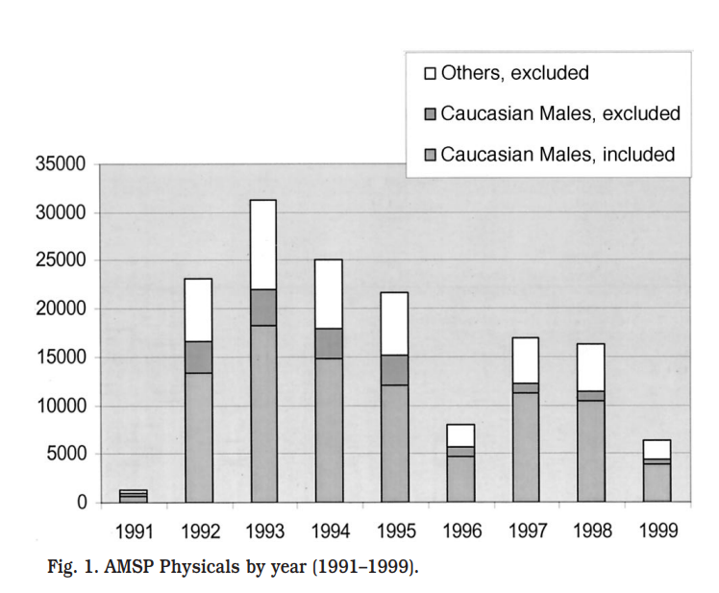
results
Figure 1 presents the number of physicals reported in calendar years 1991 to 1999 for Caucasian men included in the study.
For unknown reasons, fewer records were entered in the database from 1996. Although not presented in graphic form,

Slide 8
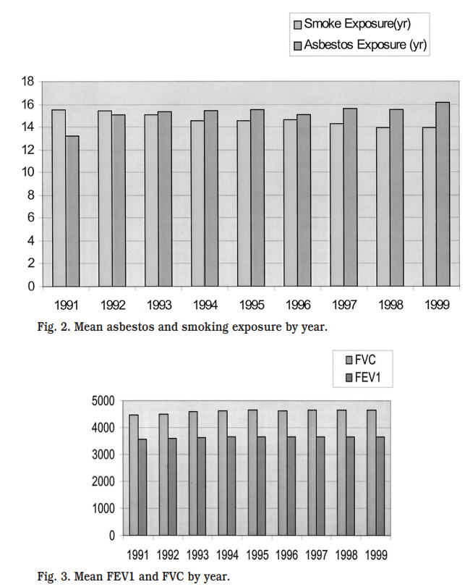
Results (Continue…)
Figure 2 presents the mean duration for smoking and asbestos exposure for personnel in the study.
The duration of asbestos exposure increased significantly over the period .
The mean duration of smoking decreased significantly during the period .
Figure 3 displays mean FEV1 and FVC for the population. FEV1 increased significantly over the period .
FVC also increased significantly over the period.

Slide 9
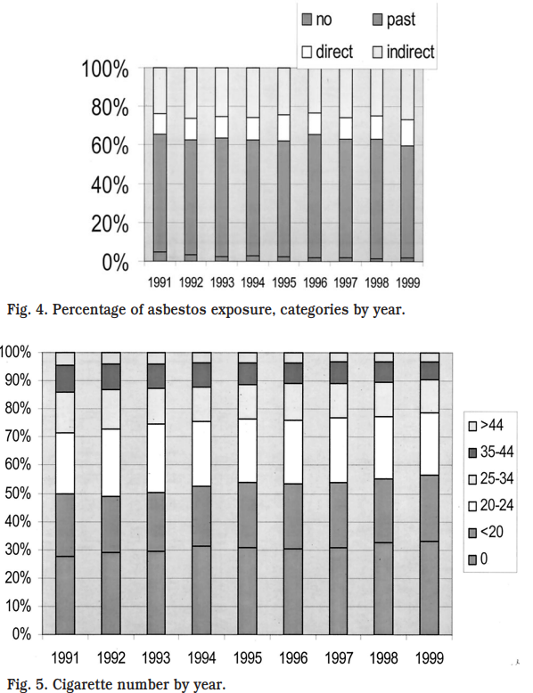
Results (Continue…)
Figure 4 displays asbestos exposure categories by year of the study and demonstrates that a large segment of the population had “previous” exposure only.
Figure 5 displays the history of cigarette smoking in the population by year and suggests that over the period of the study, the overall number of cigarettes smoked per person decreased.
The current smoking rate also decreased significantly during the period
Thus, multiple baseline variables changed significantly over the period, which suggested including a variable in the final analysis for year of the examination.

Slide 10
Discussion
The results suggest that the overall pulmonary functioning improved over the period after adjusting for age, height, weight, smoking, and asbestos exposure.
The study found significant negative interaction between smoking and asbestos exposure, most apparent in the overall, previous, and indirect exposure categories, but not in those with current, direct exposure.
Improvement Case:
The AMSP has long included active counseling on smoking cessation, and these findings strongly support that program.
The ethnic and gender subgroups omitted from this study could be studied, although the sample sizes would be smaller and we do not anticipate they would generate different results.
Analysis of changes over time for individuals with multiple asbestos examinations would be possible. Integration of radiographic data into the physical examination data would also generate several interesting study designs to resolve unknowns in disease and symptom progression.

Slide 11
Conclusion
This linear regression analysis for personnel in the AMSP from 1991 to 1999 found that coefficients for age, height, weight, and smoking exposure were statistically significant and generally consistent.
Linear regression using asbestos exposure as a continuous variable found that coefficients for asbestos exposure were small and were not statistically significant or were slightly protective.
Statistically significant, negative interaction was demonstrated for smoking and asbestos exposure.
These findings support ongoing efforts in the current asbestos abatement program.

Slide 12
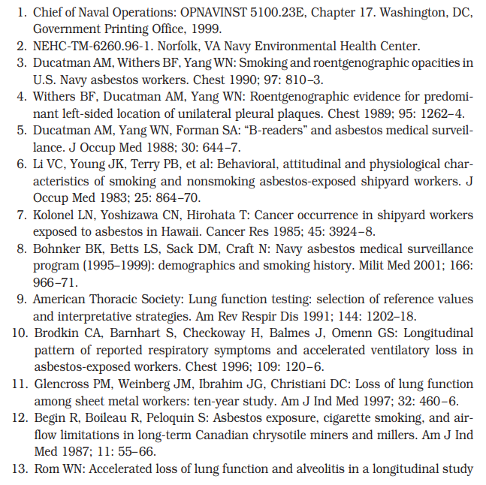
reference

